Slide 1
Workflow with example
our goal was to train a deep learning model to identify cancer.
Our input would be an RBG image, which can be represented as a vector of pixel values.
Our output would be a probability distribution over three mutually exclusive possibilities:
1) normal,
2) benign tumor (a cancer that has yet to metastasize),
or 3) malignant tumor (a cancer
that has already metastasized to other organs).

Slide 2
The reason for this is that the complexity of this network is too high

Slide 3
we need to build a neural network architecture to solve it.
Our input layer would have to be of appropriate size to accept the raw data from the image
our output layer would have to be a softmax of size 3.
We need to define the internal architecture of the network.
we also want to collect a significant amount of data for training or modeling.
This data would probably be in the form of uniformly sized pathological images that have been labeled by a medical expert.
We shuffle and divide this data up into separate training, validation, and test sets.

Slide 4
We train the model on our training set for an epoch at a time.
At the end of each epoch, we ensure that our error on the training set and validation set is decreasing.
When one of these stops to improve (means if error is not decreasing), we terminate and make sure we’re happy with the model’s performance on the test data.
If we’re unsatisfied, we need to rethink our architecture or reconsider whether the data we collect has the information required to make the prediction we’re interested in making.
If our training set error stopped improving, we probably need to do a better job of capturing the important features in our data.
If our validation set error stopped improving, we probably need to take measures to prevent over fitting.

Slide 5
If, however, we are happy with the performance of our model on the training data,
then we can measure its performance on the test data, which the model has never seen before this point.
If it is unsatisfactory, we need more data in our dataset
because the test set seems to consist of example types that weren’t well represented in the training set.
Otherwise, we are finished!

Slide 6
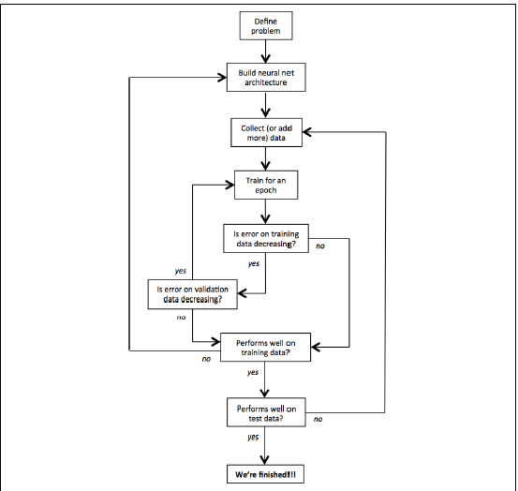

Slide 7
Methods to prevent overfitting
Overfitting is a major problem for Predictive Analytics and especially for Neural Networks
key methods to avoid overfitting include
regularization (L2 and L1)
Max norm constraints
Dropout.

Slide 8
Regularization
Regularization modifies the objective function that we minimize by adding additional terms that penalize large weights.
In other words, we change the objective function so that it becomes Error + λ f( θ)
where f( θ )grows larger as the components of θ grow larger, and λ is the regularization strength (another hyperparameter).
The value we choose for λ determines how much we want to protect against overfitting.
A λ = 0 implies that we do not take any measures against the possibility of overfitting.
If λ is too large, then our model will prioritize keeping θ as small as possible
choosing λ is a very important task and can require some trial and error.

Slide 9

L2 Regularization
The most common type of regularization in machine learning is L2 regularization.
It can be implemented by augmenting the error function with the squared magnitude of
all weights in the neural network.
In other words, for every weight w in the neural
network, we add to the error function
using the L2 regularization ultimately means that every weight is decayed linearly to zero. Because of this phenomenon, L2 regularization is also commonly referred to as weight decay.

Slide 10
L1 Regularization
Another common type of regularization is L1 regularization.
Here, we add the term λ|w| for every weight w in the neural network.
The L1 regularization has the intriguing property that it leads the weight vectors to become sparse during optimization (i.e., very close to exactly zero).
In other words, neurons with L1 regularization end up using only a small subset of their most important inputs and become quite resistant to noise in the inputs.
In comparison, weight vectors from L2 regularization are usually diffuse, small numbers. L1 regularization is very useful when you want to understand exactly which features are contributing to a decision.
If this level of feature analysis isn’t necessary, we prefer to use L2 regularization because it empirically performs better.

Slide 11
Max norm constraints
They have a similar goal of attempting to restrict θ from becoming too large, but they do this more directly.
Max norm constraints enforce an absolute upper bound on the magnitude of the incoming weight vector for every neuron and use projected gradient descent to enforce the constraint.
In practice, this corresponds to performing the parameter update as normal, and then enforcing the constraint by clamping the weight vector of every neuron to satisfy ∥w⃗ ∥₂<C
Typical values of C are on orders of 3 or 4

Slide 12
Dropout
there are some important intricacies to consider. First, we’d like the outputs of neurons during test time to be equivalent to
their expected outputs at training time.
We could fix this naively by scaling the output
a t test time.
This is easy to see because a neuron’s output is set to 0 with probability 1 − p. This means
that if a neuron’s output prior to dropout was x, then after dropout, the expected output
would be E [output] = px + (1 − p )・ 0 = px.

Slide 13
This naive implementation of dropout is undesirable, however, because it requires scaling of neuron outputs at test time.
Test-time performance is extremely critical to model evaluation
so it’s always preferable to use inverted dropout, where the scaling occurs at training time instead of at test time.

Slide 14
In inverted dropout, any neuron whose activation hasn’t been silenced has its
output divided by p before the value is propagated to the next layer.
With this fix, E [output ]= p ・ x/p + (1 − p )・ 0 = x,
and we can avoid arbitrarily scaling neuronal
output at test time

Slide 15
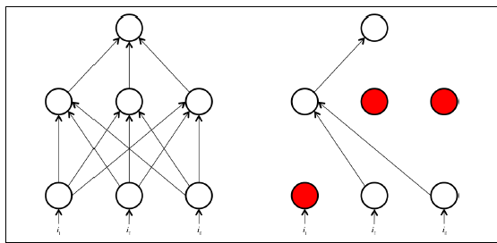

Slide 16

https://www.analyticsvidhya.com/blog/2018/04/fundamentals-deep-learning-regularization-techniques/

